Slide 1

OpenShift Tutorial
TP5 - Log3000 — A2018
Armstrong Foundjem
MCIS — Laboratory

Slide 2



Let’s watch this video

Slide 3

Let’s watch this video

Slide 4

PaaS
IaaS

Slide 5

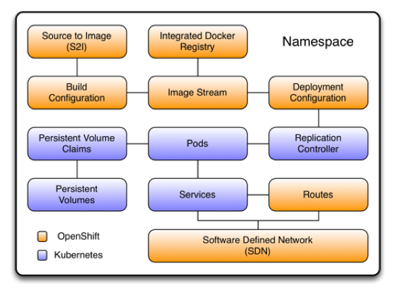


OpenShift, platform as a service (PaaS) ODK Red Hat builds on Docker and K8s.
DevOps can deliver faster with containers and Kubernetes
Focus on coding while OpenShift build, run, and scale your apps in the cloud
K8s, container as a service (CaaS) an open source project from Google

Slide 6


https://learn.openshift.com/introduction/getting-started/

Slide 8


Slide 9

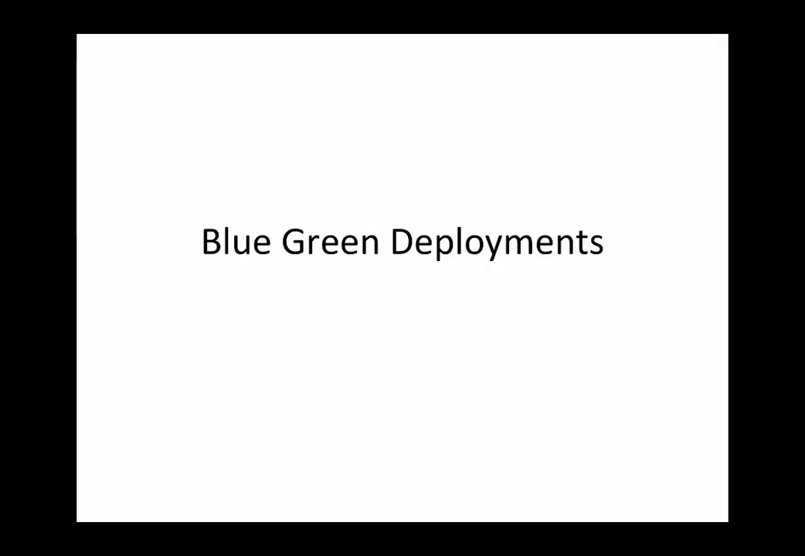
Let’s watch this video

Slide 10

https://access.redhat.com/documentation/en-us/openshift_container_platform/3.7/html/upgrading_clusters/upgrading-blue-green-deployments
https://opensource.com/article/17/5/colorful-deployments

Slide 11

Q1. What is the relationship between the command oc (cli) and MiniShift (OpenShift)
Q2. What is the relationship between OpenShift snd Kubernetes?
Q3. In the world of OpenShift, what is a project and a namespace?
Q4. In your own words, what is kubernetes and why is it useful for DevOps?
Q5. Can more than one projects have the same name, why(not)?

Slide 12

Q6. What does it mean to scale your application? Explain the different between horizontal scaling vs vertical scaling.
Q7. What is a pod? Explain how they work.
Q8. What is “Application self-healing”
Q9. What is the purpose of routing?
Q10. Explain and describe the meaning of application deployments from source code to the end point.

Slide 13
Q11. From “Interactive Learning Portal” interface, select any two scenarios of your choice and explain the main task they describe.
Q12. In each step, briefly explain the purpose and what the step aims to achieve.
Q13. Give five oc commands with options and explain what they aim at archiving.
Q14. Give five oc commands without option and explain what they aim at achieving.
Q15. What is a volume and how useful it is?

Slide 14

Q16. Build a blue-green application that switches the color of a page/screen from blue to green and vice-versa. (5pts)
Bonus: Scale out your applications to 10 instances on blue and green and scale in back to 1 each. 2pts
NB: Q16 is obligatory! If you do not answer this question, your TP will not be marked and if you have less than 2pts on Q16, you will be given 0/5.

Slide 15
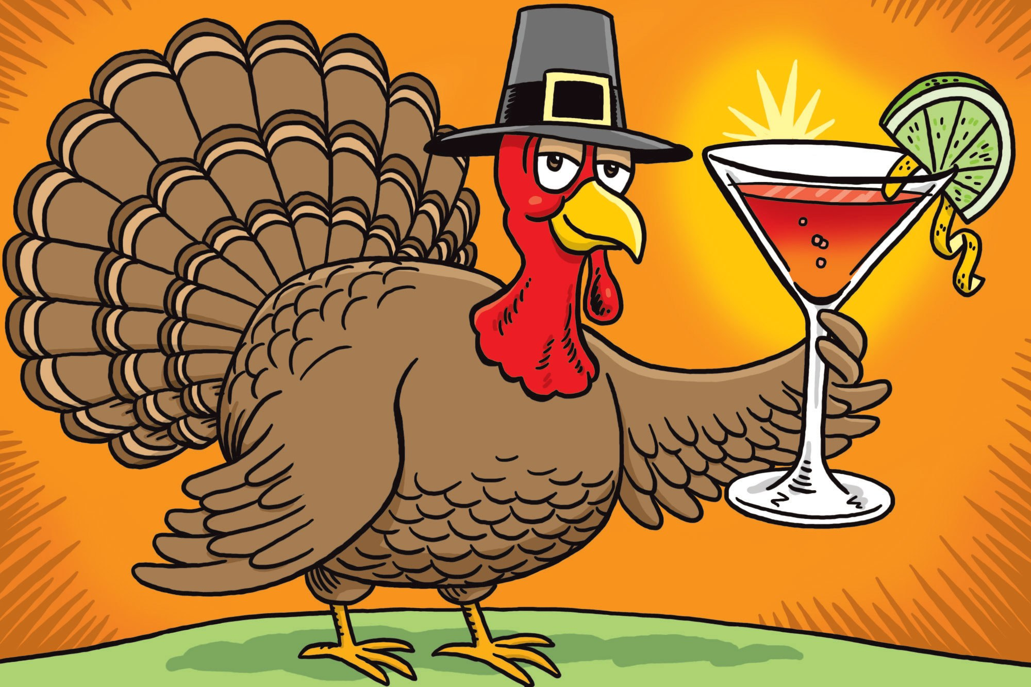
Fin
Good luck!

Slide 16

Supplementary Materials for your knowledge bank only.
https://www.katacoda.com/courses/kubernetes
https://www.katacoda.com/courses/kubernetes/launch-single-node-cluster
https://kubernetes.io/docs/tutorials/kubernetes-basics/deploy-app/deploy-interactive/
https://kubernetes.io/docs/tutorials/hello-minikube/

